Slide 1
House Grade Classification
Samraddhi Shrivastava​

Slide 2
Business Objective
Build a predictive model to determine the Grade of house (The grades are A,B,C,D, and E).

Slide 3
Introduction
Property buyers have different requirements. To facilitate this, real estate companies prefer categorizing various houses into different grades based on various parameters. This would help agents in identifying the type of house a customer is looking for. This way, the search for the house can be narrowed down by focusing only on the ‘condition of the house’. The Grade (condition of the house that ranges from A-E
(Worst) ) can also be used by existing owners to list their properties for sale. Grading helps them in arriving at a price of the house.

Slide 4
Min Max count of all variable Analysis
anb
area_total
nbwashrooms
lawn_area
grade
Minimum | 290
Maximum | 360
Minimum | 1
Maximum | 8
3 | 1270
2 | 716
1 | 539
0 | 399
4 | 76
Minimum | 70
Maximum | 120
Minimum | 1
Maximum | 6
trooms
9 | 641
6 | 634
7 | 586
5 | 574
8 | 565
twashrooms
nfloors
expected_price
Minimum | 2
Maximum | 10
Minimum | 1
Maximum | 7
Minimum | 2504
Maximum | 5216
nbedrooms
api
roof
Minimum | 2
Maximum | 8
Minimum | 40
Maximum | 100
1 | 1543
0 | 1457

Slide 5
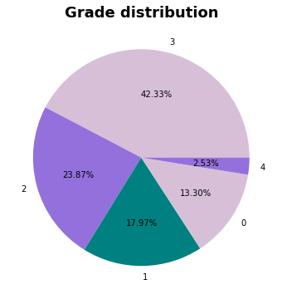
Grade Distribution
Interpretation ::::
from this pie plot, we can say that the highest rooms are from grade 3 and grade 4 have the least.

Slide 6
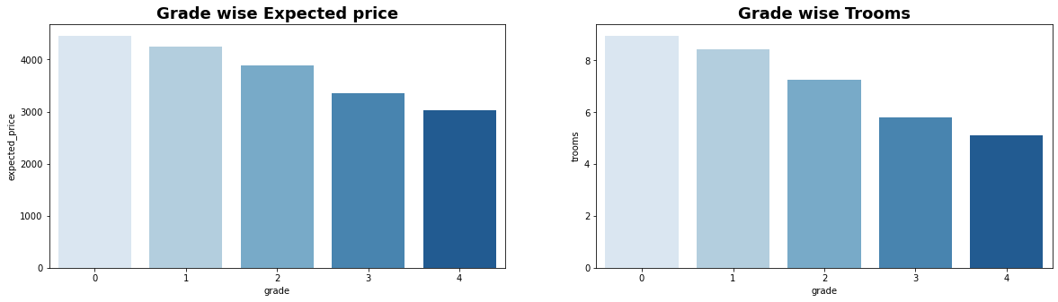
Grade-wise Expected Price and Grade-wise trooms
Interpretation ::::¶
By the first graph, we can say that 0 grade has the highest price, and 4 has the least, but people who want an affordable house with some good facilities, can be shown with grade 2 houses, as we can in plot two grade 2 have enough(6-7) number of rooms with affordable price

Slide 7
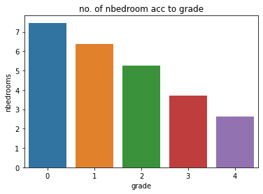
Number of bedrooms acc to grade
Interpretation ::::
The number of bedrooms is highest in grade 0 and least in grade 4, the customer with a small family can be suggested with grades 3 and 4 also if the budget is less, and if the customer is with a big family then grade 1 and 2 will be better but as grade will increase expected price will also increase.

Slide 8
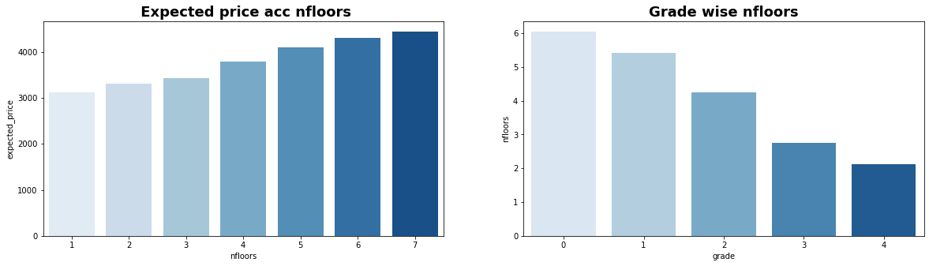
Price acc to floor and Grade Acc to nfloors
Interpretation ::::
from the above plot we can say that as number of floor is increasing expected price and grade is also increasing

Slide 9
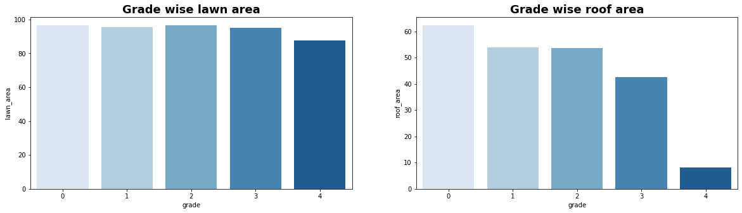
Grade wise Lawn Area and Grade Wise roof area
Interpretation ::::
if one wants lawn area then one can go with grades 0,1,2 also if one wants more roof area then one can go with grades 0 and 1, but as we know the expected price will increase with an increasing grade so if one wants a minimum good roof area then can go with grade 3 house where roof area is good enough, but for big lawn area one must pay more.

Slide 10
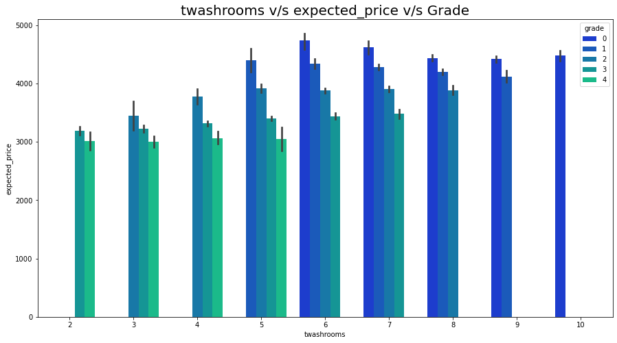
twashrooms v/s expected_price v/s Grade
Interpretation ::::
from the above graph I can say that with 2,3,4 number of washroom price is comparatively less and as the number of the washroom is increasing expected price is also increasing

Slide 11
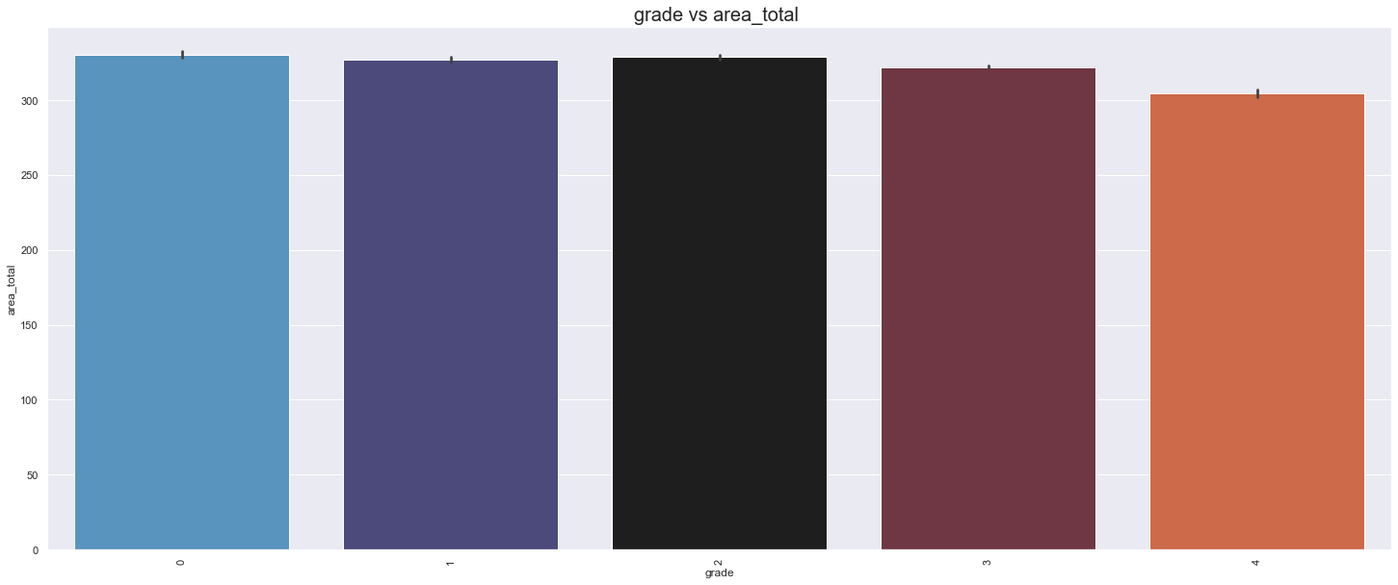
Grade vs Area
Interpretation ::::
we can see that area is not very much affecting the grade

Slide 12
Plot for Final Comparison
model | score
0 | Baseline decision tree classifier | 0.516597
1 | Bagging with random forest with Kfold | 0.822739
2 | Adaaboost with Kfold | 0.898021
3 | Stacking | 0.574382

Slide 13
FINAL INTERPRETATION ::::
Business Analysis :::
we can suggest grades 3 and 4 to people who are having a small family and also want a house at an affordable price.
people who are not having any budget issues and want to live with more comfort can be suggested with grades 1 and 2.
Model selection for house grade predictions ::::
After making 4 models I will choose AdaBoost with the fold method model for future predictions of the grade of the house which is giving me the highest accuracy score.

Slide 14
Thank you

